Slide 1

Haptic Object Recognition:
Validating results produced by ‘The visual and haptic perception of natural object shape’
ECS794P – MSc Artificial Intelligence

Slide 2
Agenda
1
2
3
4
5
6
Introduction
The Paper
Inspiration
Implementation
Results
Conclusion

Slide 3
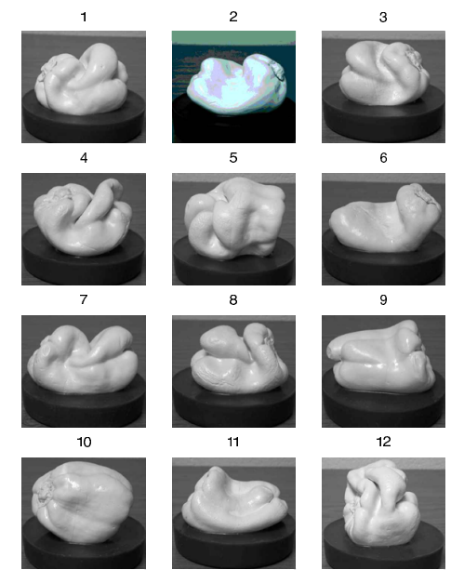
Introduction
‘The visual and haptic perception of natural object shape’ investigates how humans perceive natural object shapes through vision and touch with the use of 3d printed bell peppers.
I will explore and validate the findings from certain aspects of this study in order to understand how learnings from the experiments can be implemented to develop augmented and virtual reality technology.
I will do this by replicating part of the experiment as a ROS package that uses a Bayesian network to predict the probability of recognition accuracy for objects manipulated haptically for a specific duration.

Slide 4
The Paper
Objectives
Investigate how humans perceive natural object shapes through vision & touch.
explore the underlying mechanisms of visual and haptic shape perception
Methods
Experiment 1 - Observers haptically manipulate 1 object and then indicate which of 12 objects had the same shape.
Experiment 2 - 2 Objects were presented unimodally (vis/vis or hap/hap) or cross-modally (vis/hap or hap/vis). Observers identified is shapes were same.
Results
Participants using touch were more accurate at discriminating between objects than those using vision, especially with objects with more complex local features.
Visual and haptic shape perception may rely on different neural processes in the brain (vision relies on feedforward & touch relies on feedback).
Future Implications
Development of robots and artificial intelligence that need to be able to perceive and interact with objects in natural environments by highlighting the importance of considering vision and touch in the design of human-machine interfaces.

Slide 5
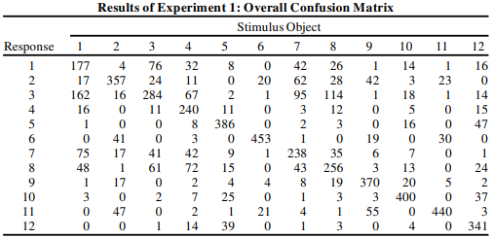
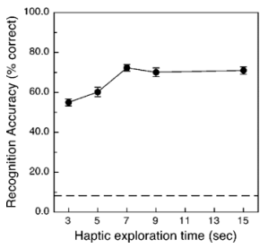
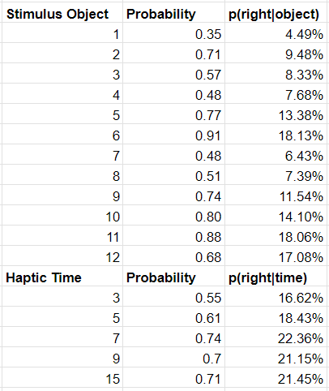
Inspiration
Experiment 1 investigates the ability of participants to identify an object they experience either haptically or visually.
When given an object to manipulate haptically, participants were given either 3,5,7,9 or 15 seconds to handle the object (without seeing it) and then shown all 12 objects and asked to identify the object they handled.
Recognition Accuracy was then recorded by object & haptic manipulation time, and results were compiled in a confusion matrix.
These aspects of experiment 1 prompted me to use these features to validate the results of this part of the study.

Slide 6
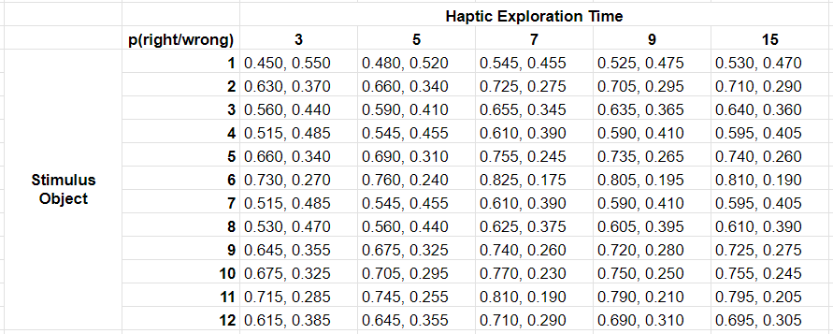
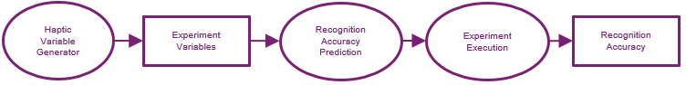
Implementation
'haptic_interaction_generator' randomly picks an object to be haptically manipulated & the amount of time allowed for manipulation.
'experiment_execution' subscribes to the topics from the first node and calls node 3 to calculate the probabilities of recognition accuracy.
3. 'recognition_accuracy_prediction' implements 'compute_recognition_accuracy' service and uses a Bayesian network to predict the probability of recognition accuracy (% likelihood of the identification being correct), given an object & time allowed to manipulate it.
ROS Architecture

Slide 7
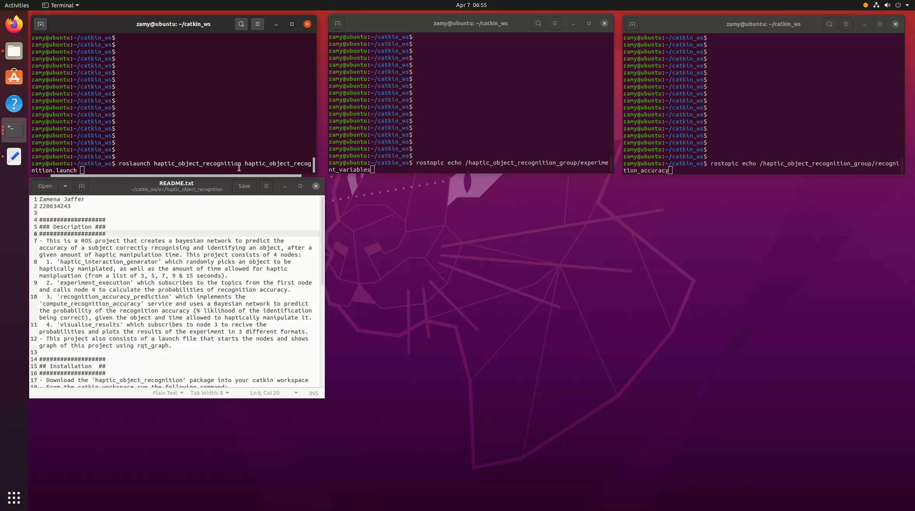

Slide 8
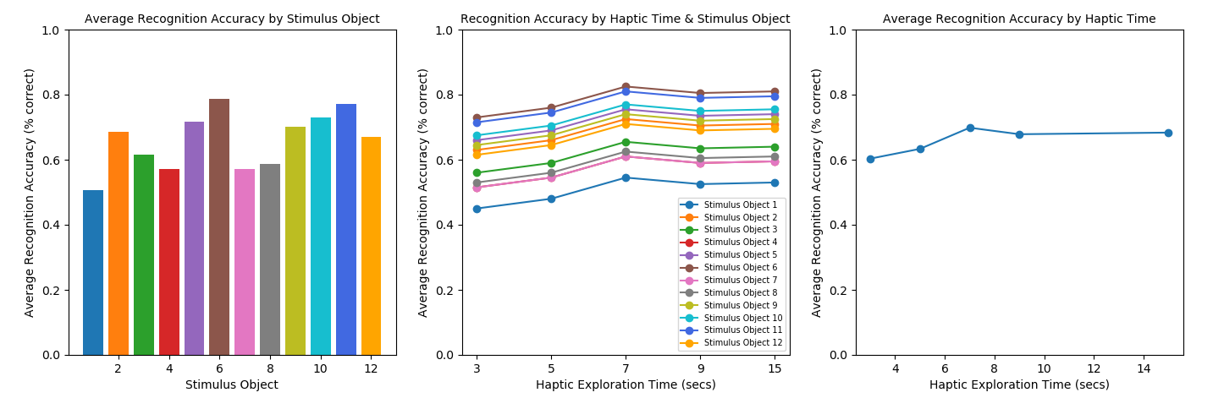
Results

Slide 9
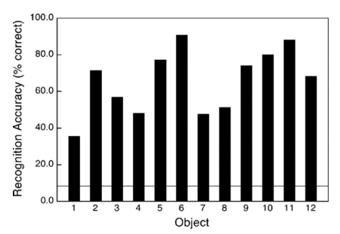
Results
Results from experiment 1 (right) identified that object 1 was the least accurately recognized object whereas object 6 was more easily identified by participants.
These trends from the original study were reflected in my implementation (left) in an attempt to validate the results with my Bayesian network.

Slide 10
Results
The original study found that from 3 to 7 seconds (secs) allowed for haptic manipulation, participants recognition accuracy significantly improved (about 32%) – but plateaued from 9 to 15 secs.
In my implementation, the Bayesian network showed similar results where recognition accuracy at 3 secs starts lowest, gradually improves by 7 secs, and then almost stagnates from 9 – 15 secs.

Slide 11
Conclusion
‘The Visual and Haptic Perception of Natural Object Shape’ provided valuable insights into the mechanisms of visual & haptic shape perception in humans.
By developing a ROS package that uses a Bayesian network to predict the probability of recognition accuracy for objects manipulated haptically, I was able to validate the findings of the original study.
This study has important implications for the development of robots and artificial intelligence that need to interact with objects in natural environments - Further development and expansion of my Bayesian network could enhance AR & VR technologies:
Utilised in AR applications to boost object detection precision. AR superimposes virtual things over the real-world, this can be difficult when objects are partially obscured or seen from different perspectives. AR applications can more precisely detect things and superimpose virtual objects onto the actual world by forecasting recognition accuracy.
The network can be incorporated to create a more realistic and immersive experience in VR. Currently, most VR systems rely heavily on visual cues to create a realistic environment. By incorporating haptic feedback into VR, users can interact with virtual objects more accurately. By predicting recognition accuracy, VR systems can better simulate the perception of natural object shapes and enable users to interact with virtual objects more accurately and comfortably.

Slide 12
Thank You

Slide 13


